Slide 1
Data for Yolo on Raspberry PI
By: Leslie Lin
Ruben Torres Romero
Ariel Suarez
Ryan Carandang

Slide 2
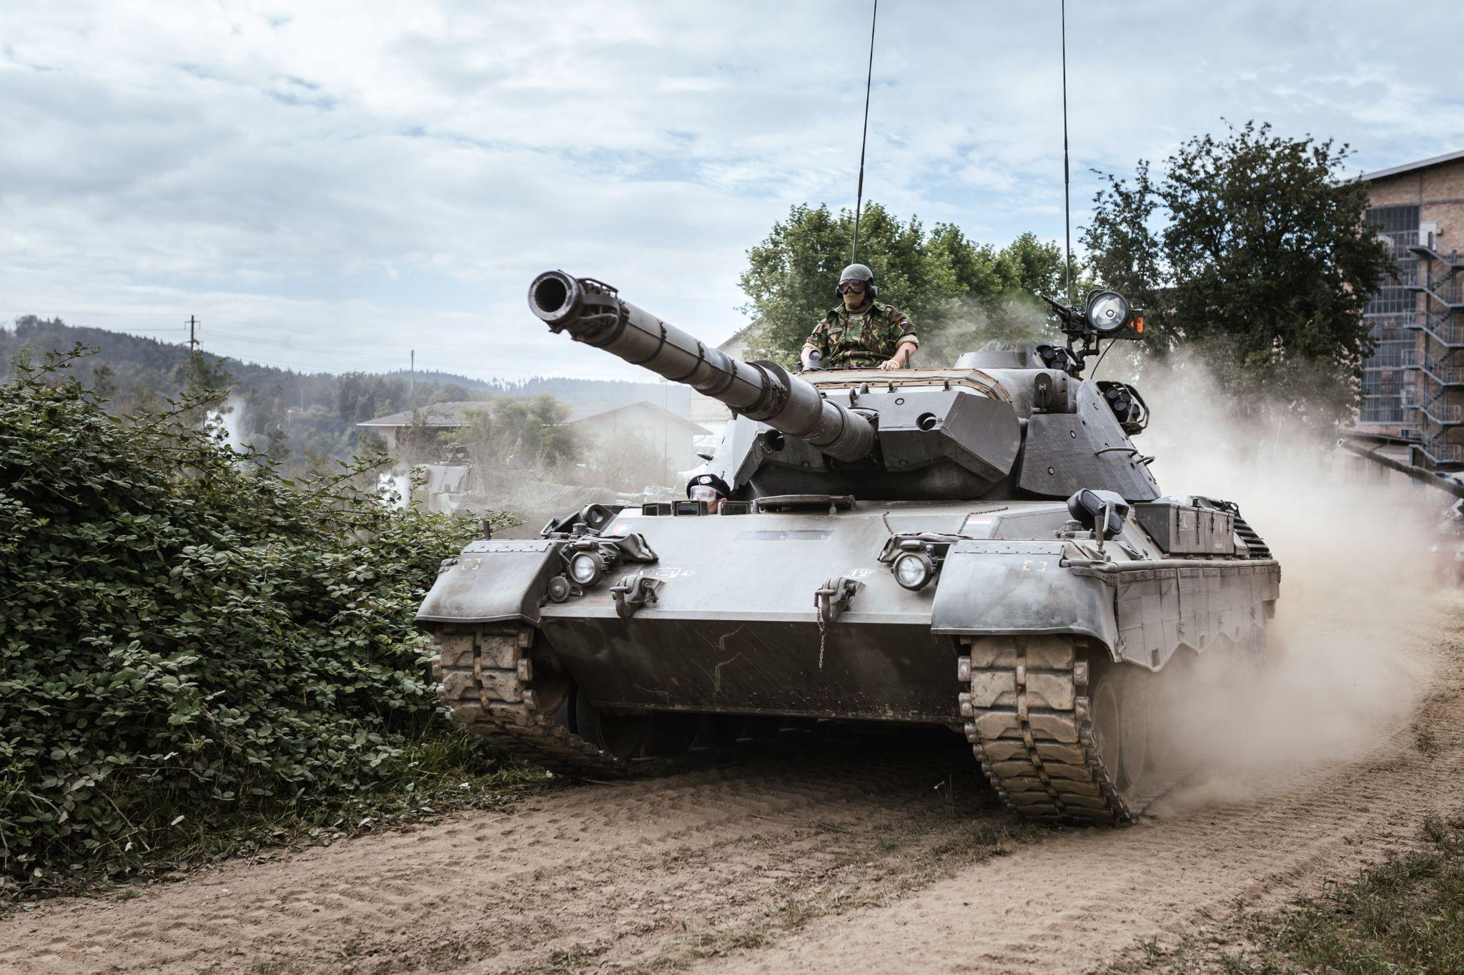
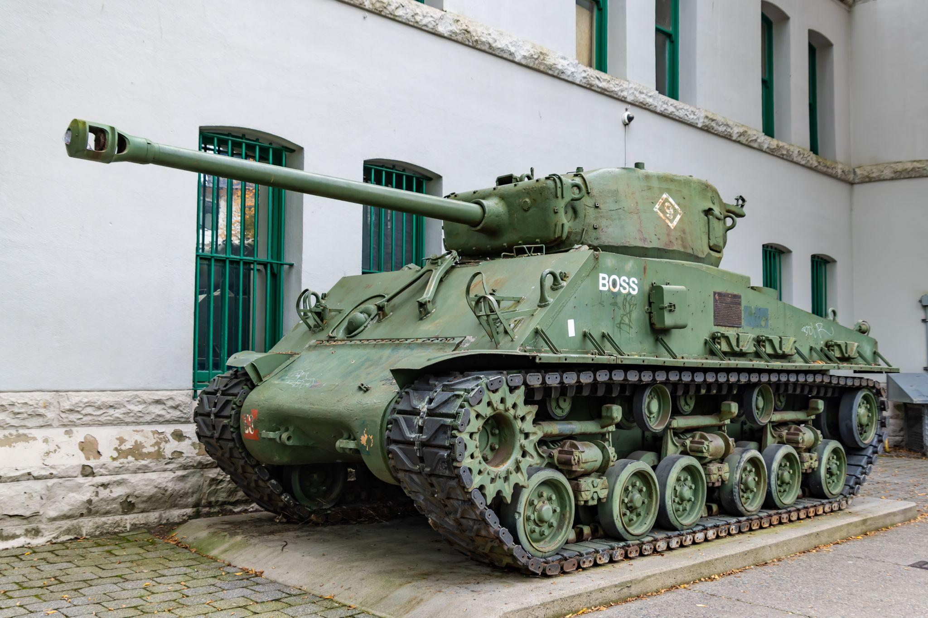
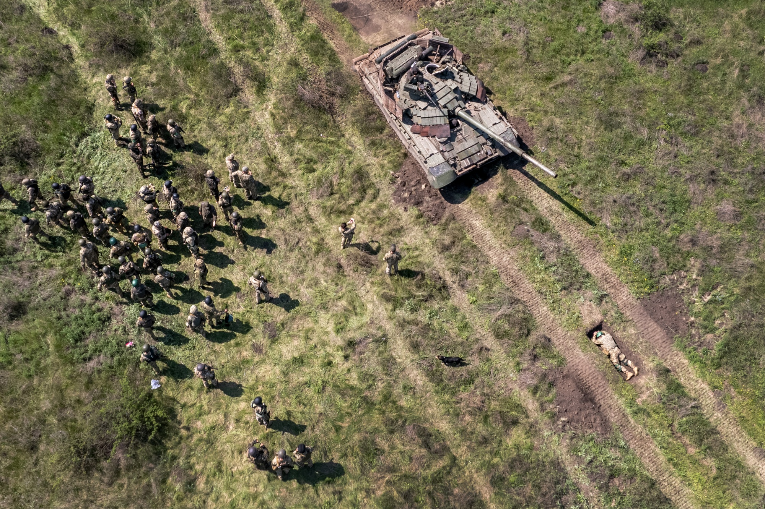
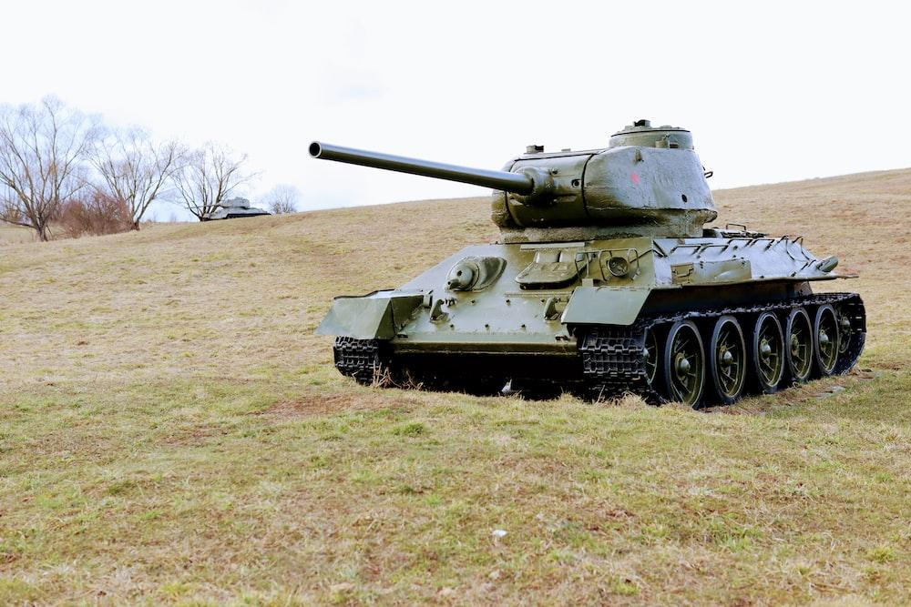
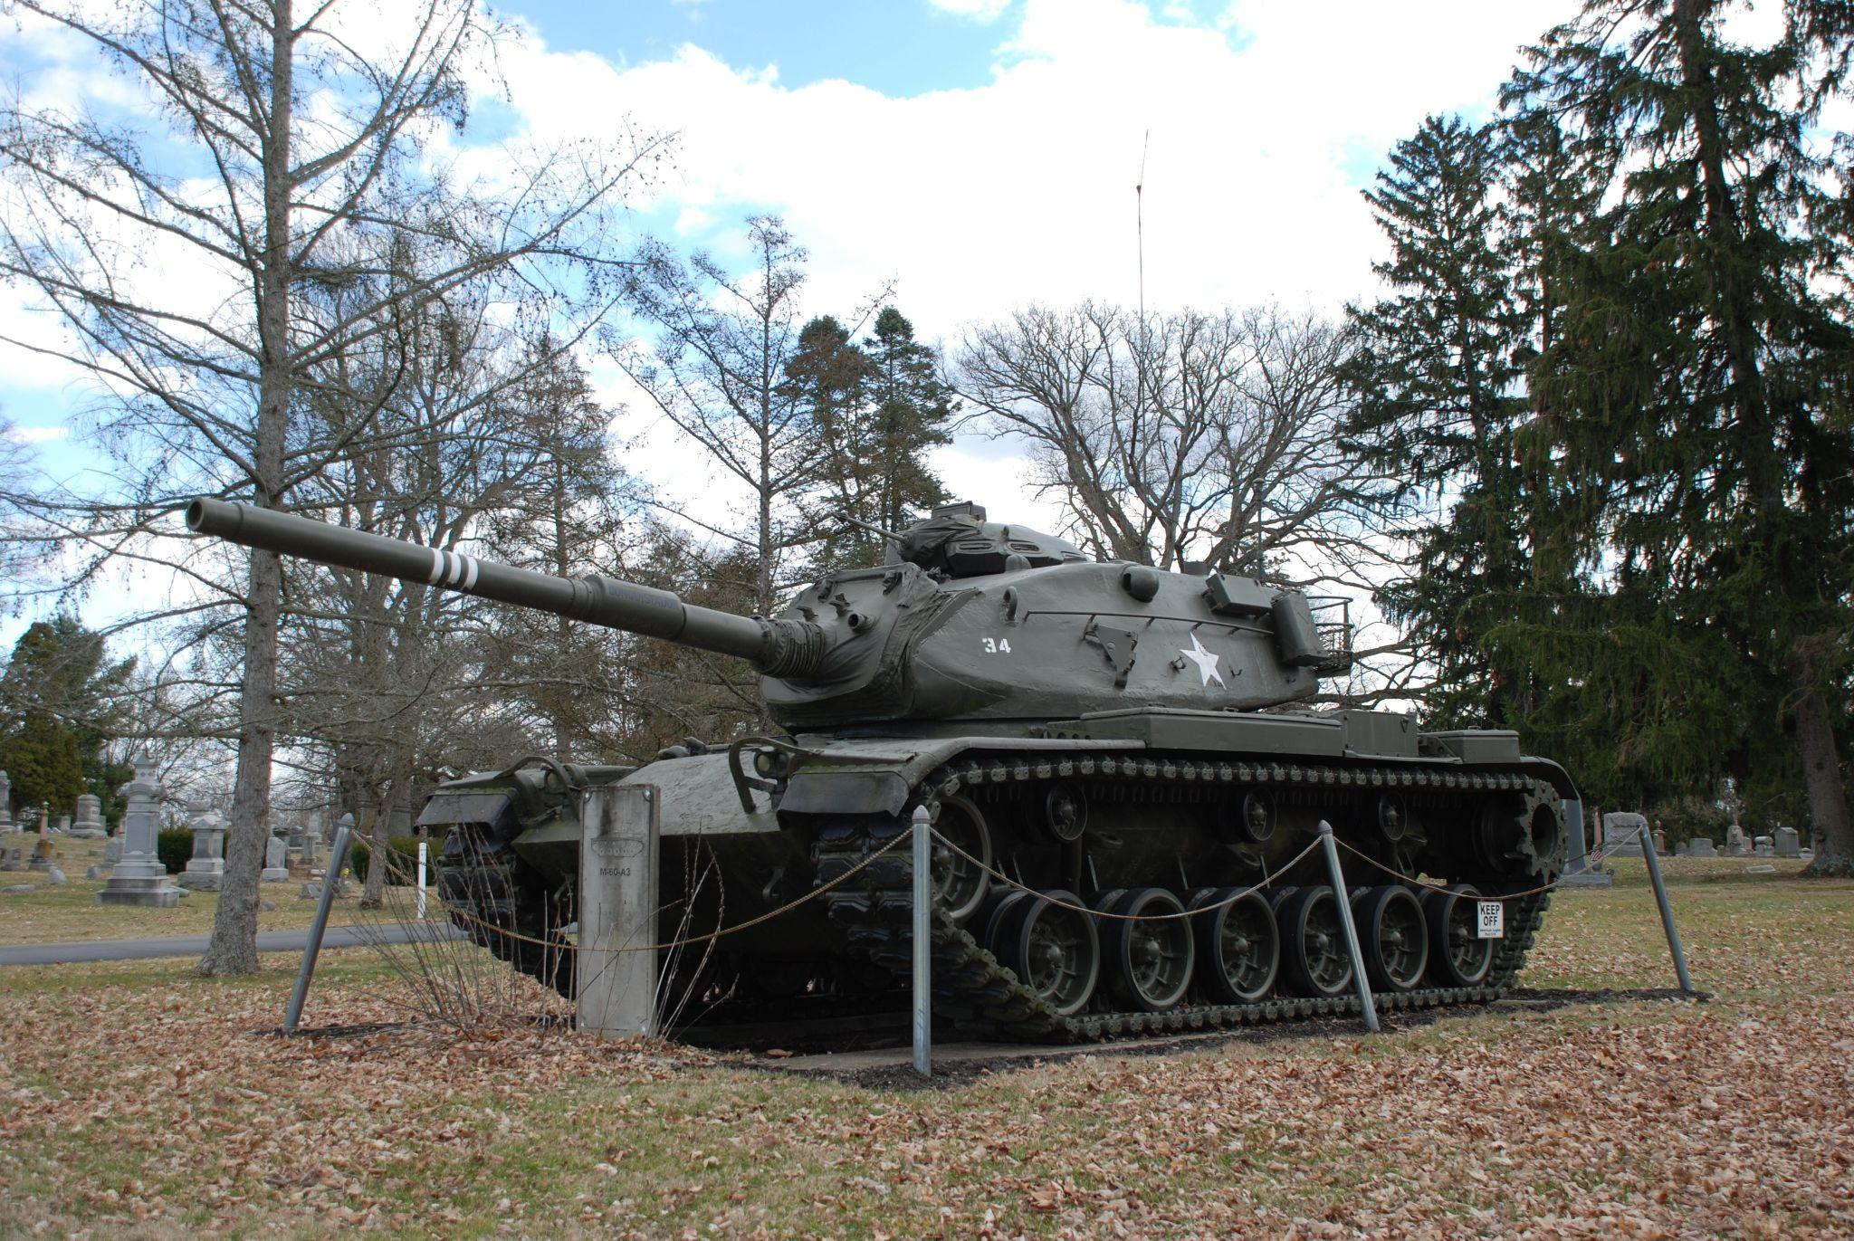
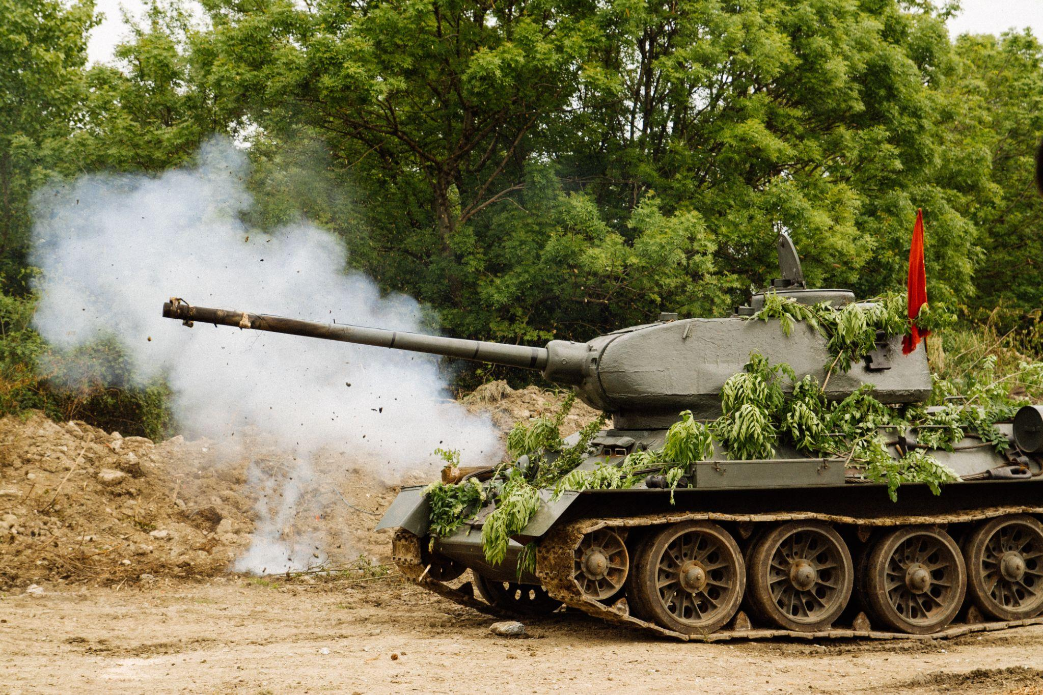
Original images
Original images

Slide 3
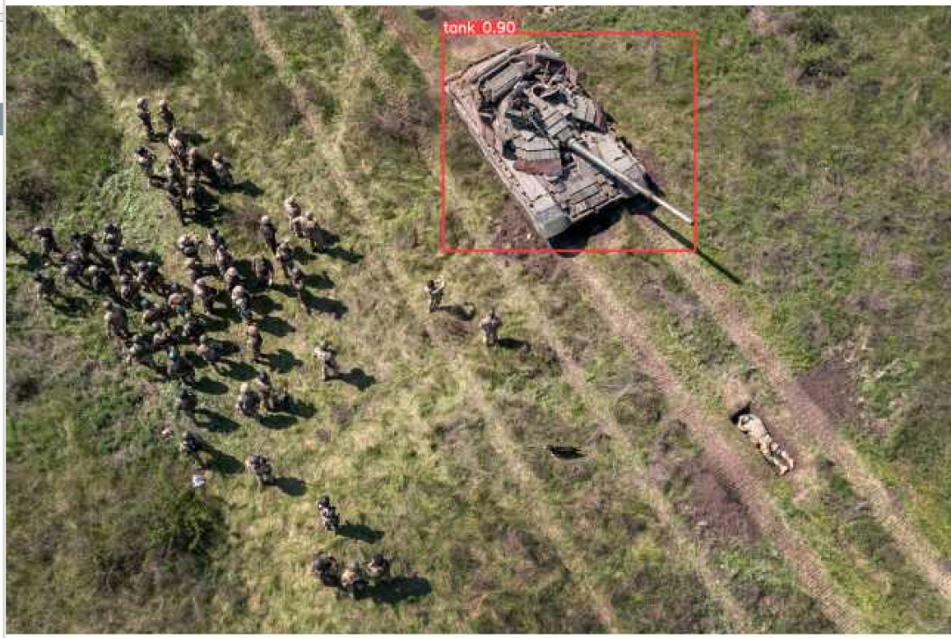
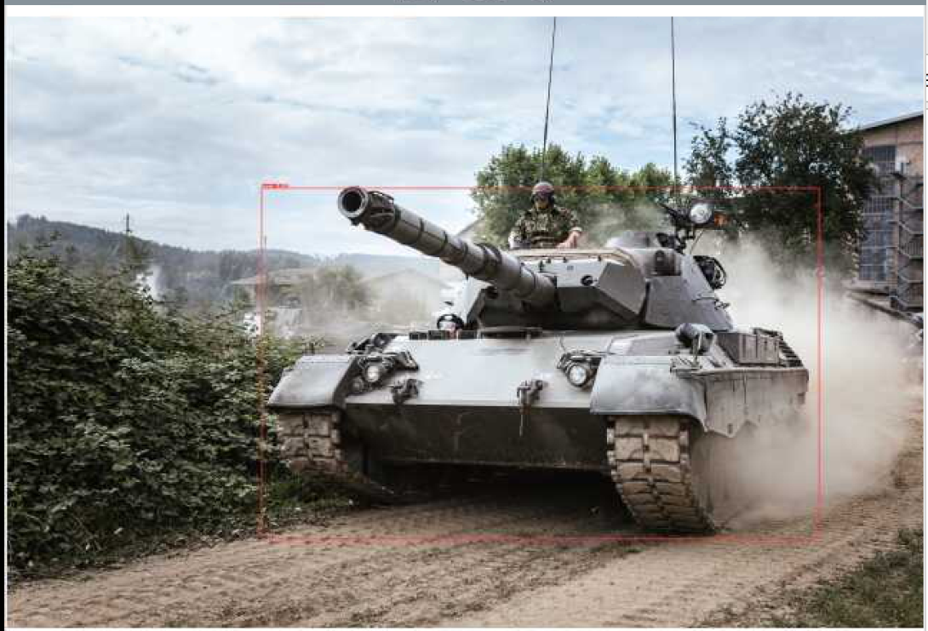
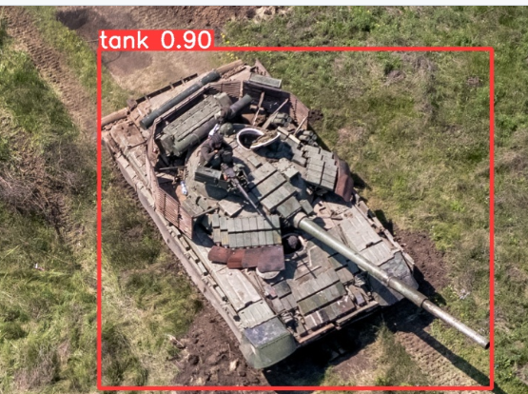
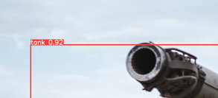
Using yolo v8 to identify tanks in images.

Slide 4
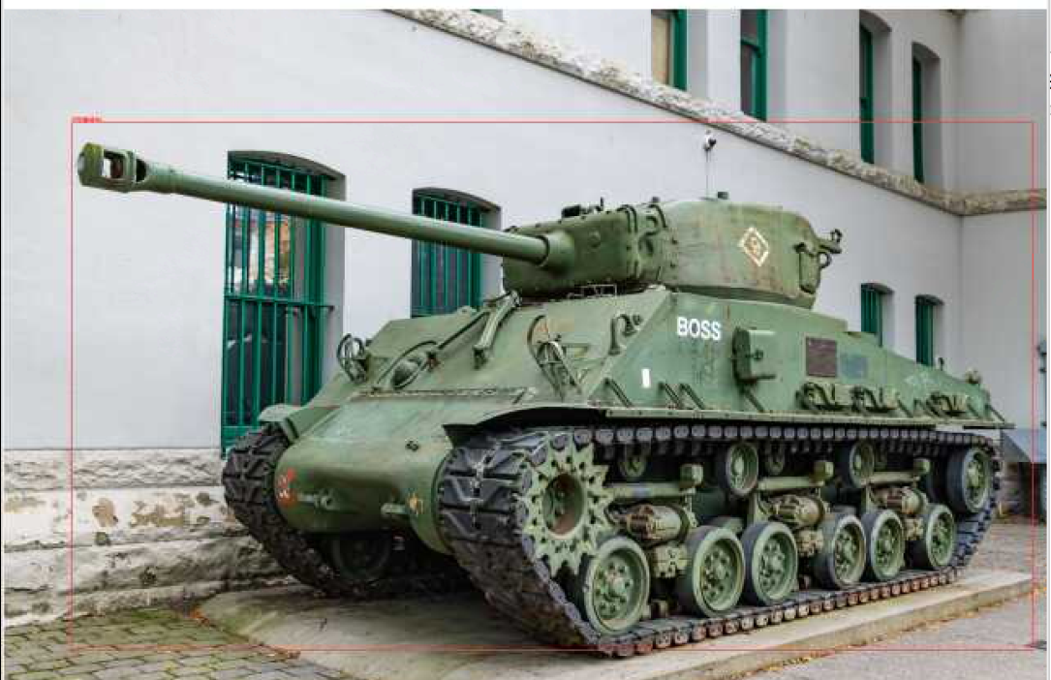
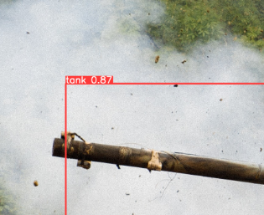
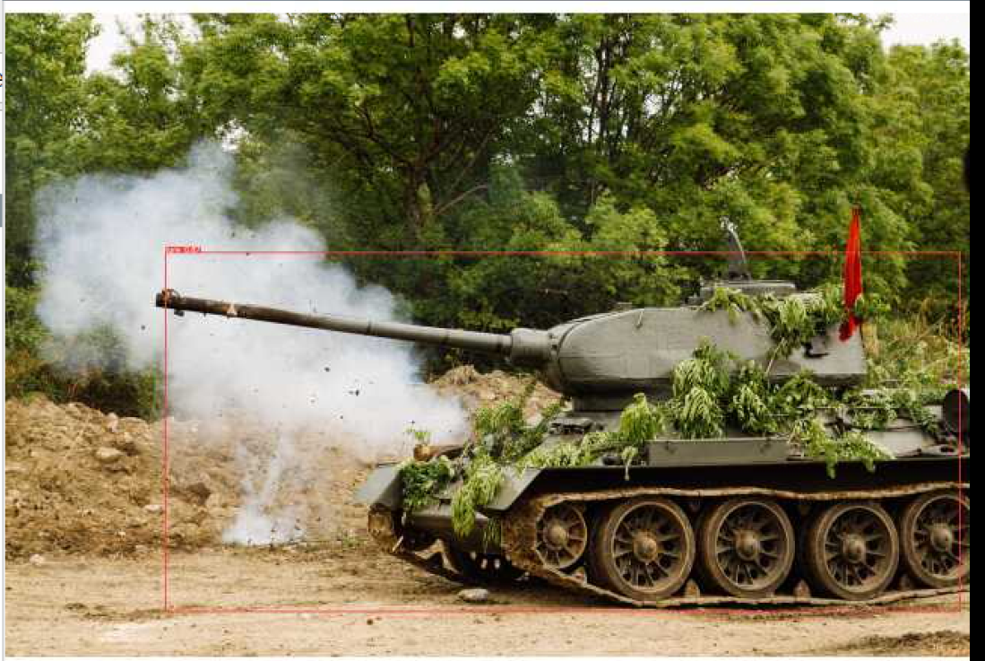
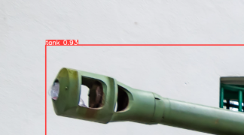

Slide 5
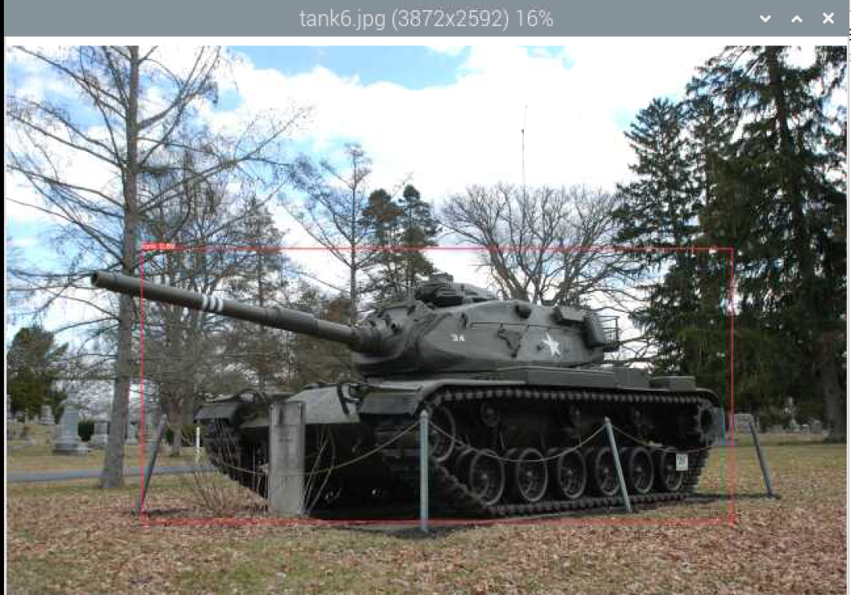
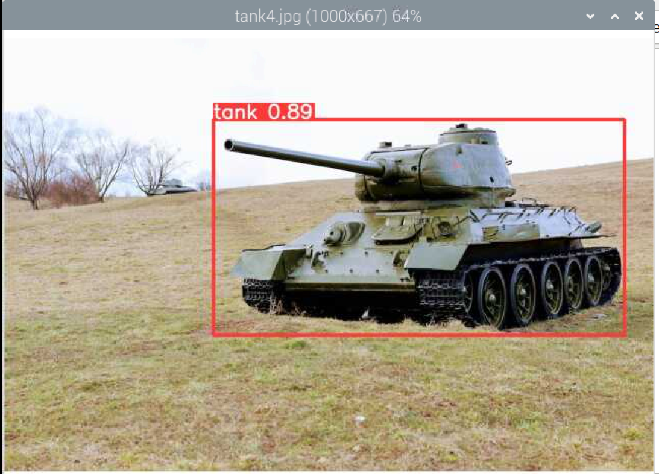
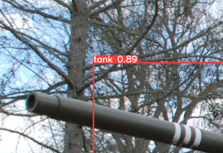

Slide 6
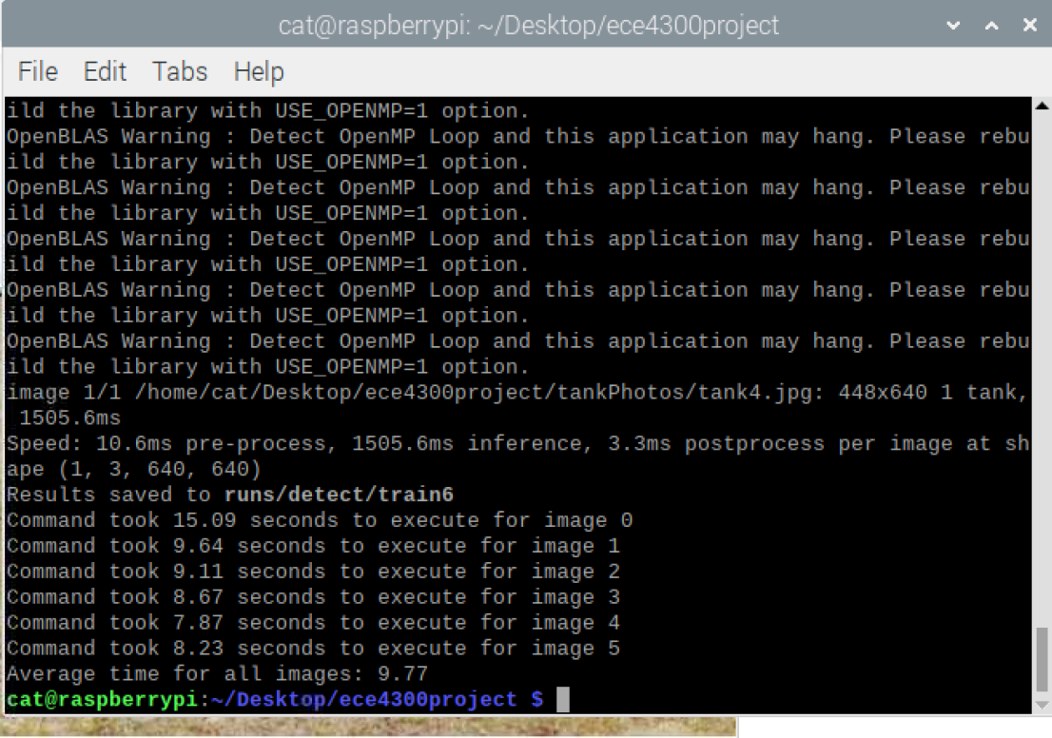
Execution time Yolov8

Slide 7
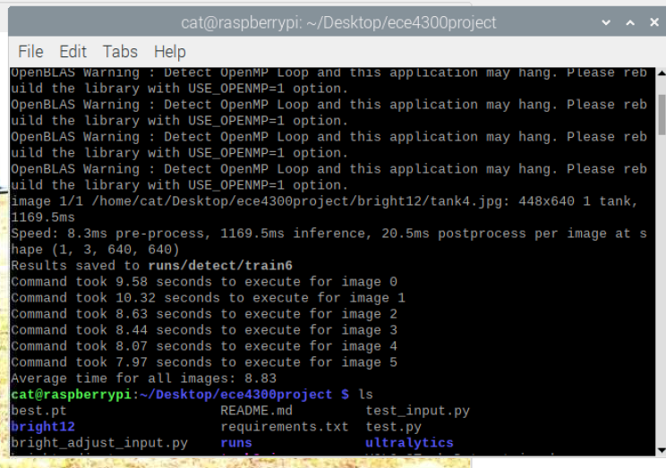
Increasing Brightness on images and then running Yolov8
Brightness 1.2:

Slide 8
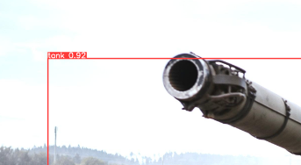
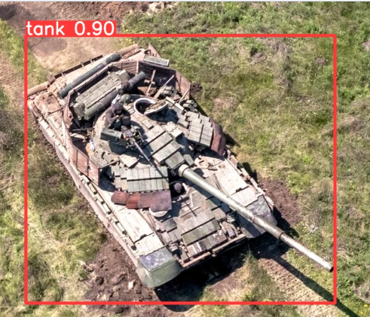
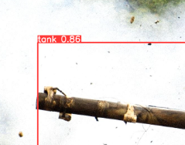
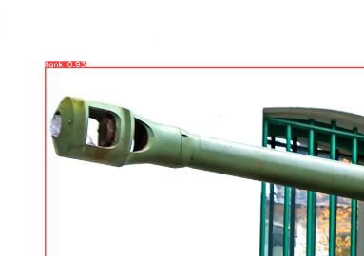
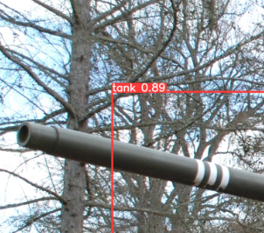
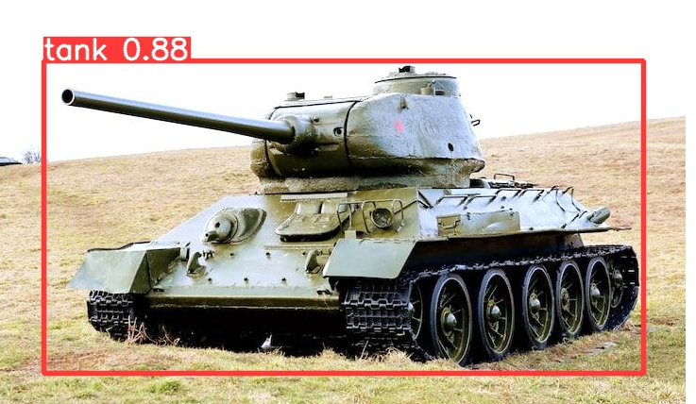

Slide 9
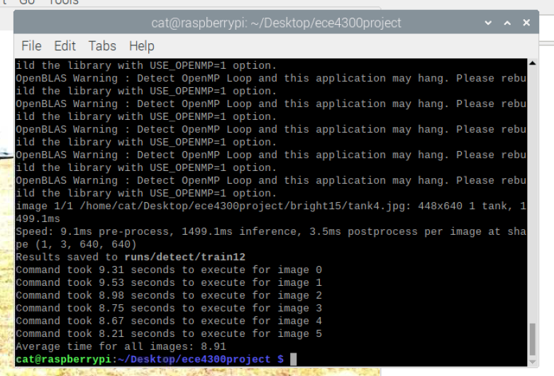
Increasing Brightness on images and then running Yolov8
Brightness 1.5:

Slide 10
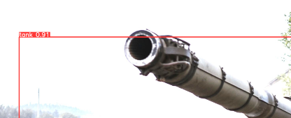
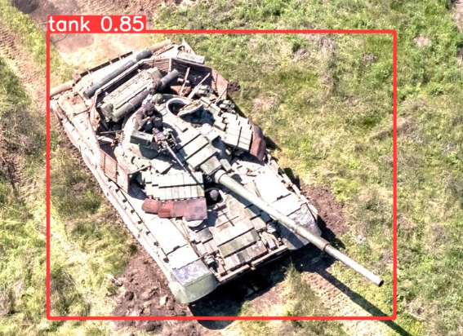
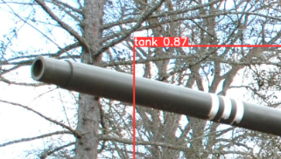
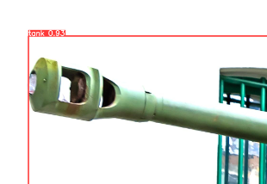
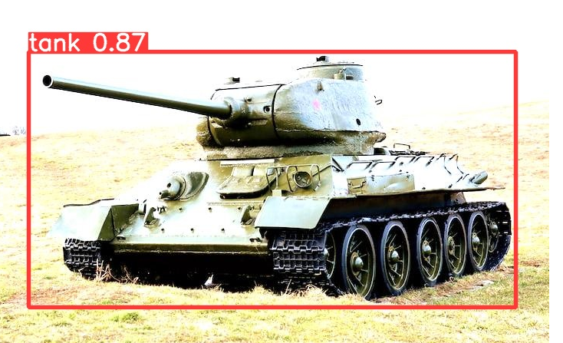
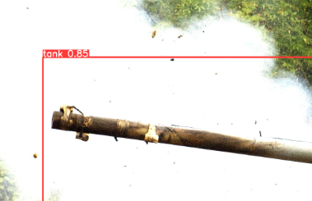

Slide 11
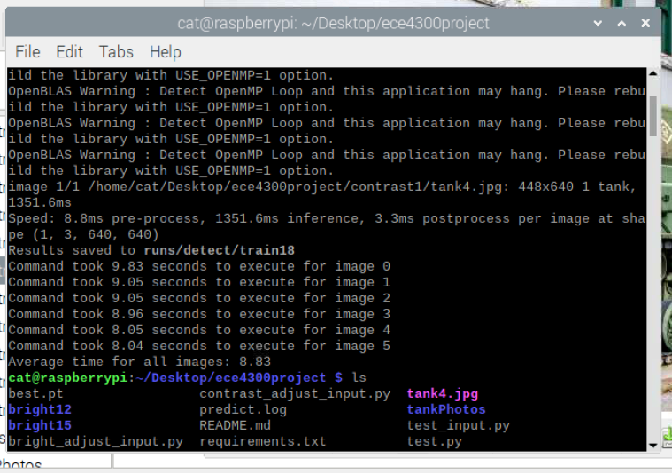
Increasing Contrast on Yolov8
Contrast: 1.2

Slide 12
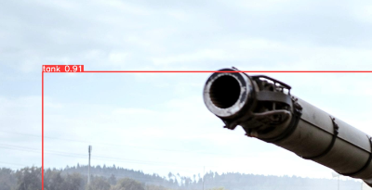
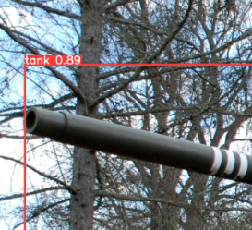
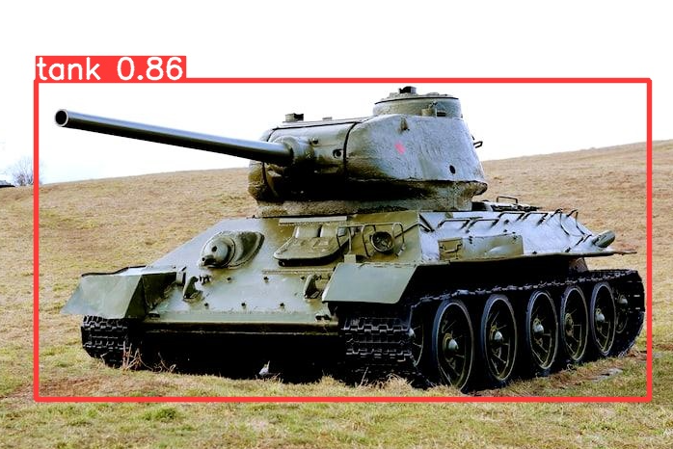
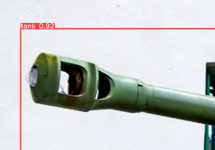
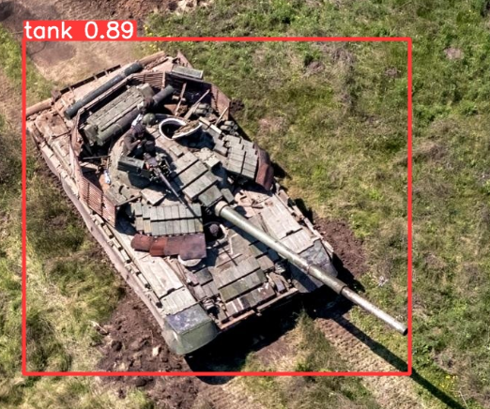
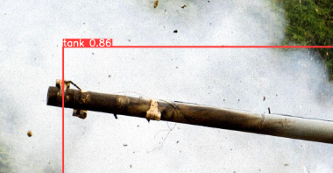

Slide 13
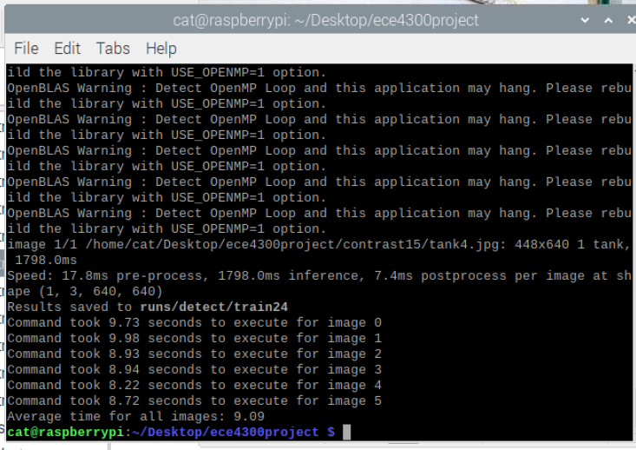
Increasing Contrast Yolov8
Contrast: 1.5

Slide 14
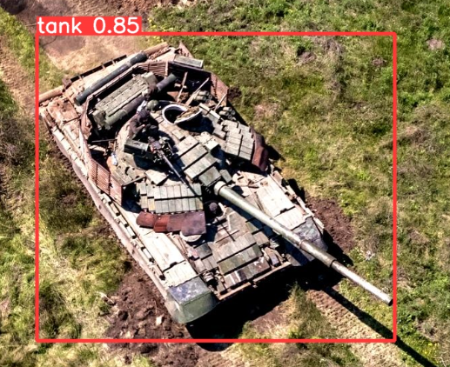
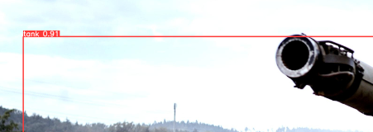
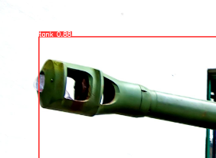
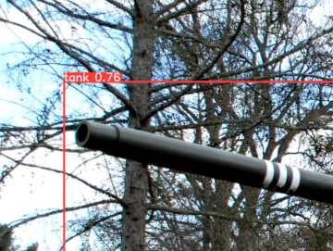
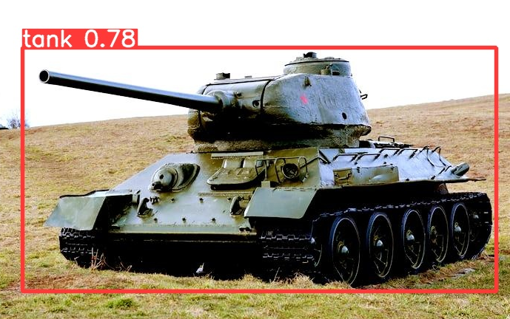
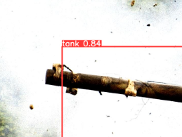

Slide 15
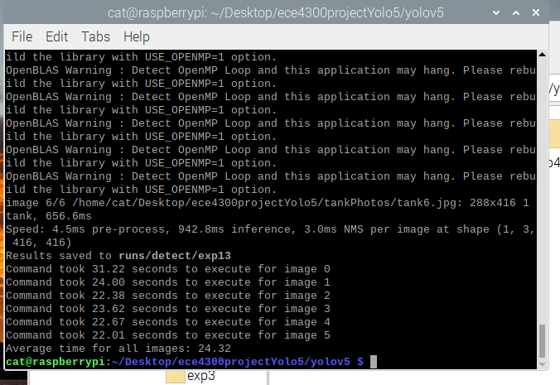
Running Yolov5
Original Images

Slide 16
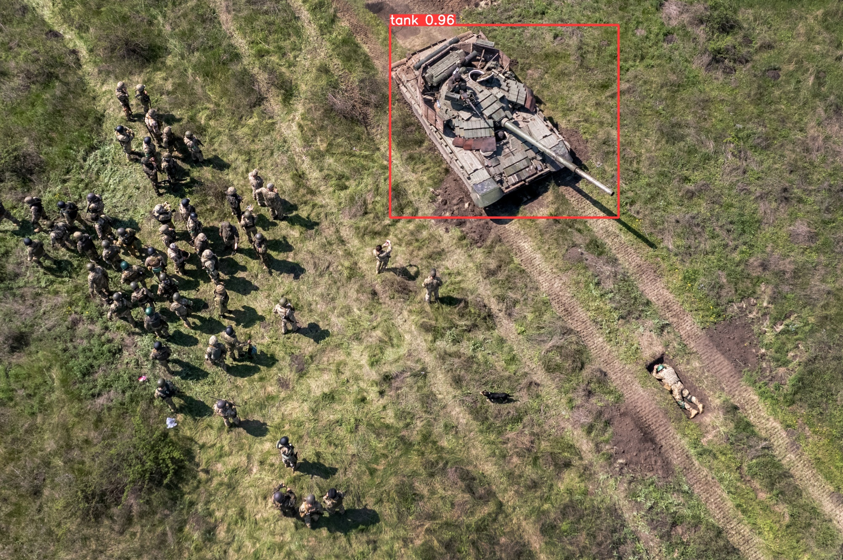
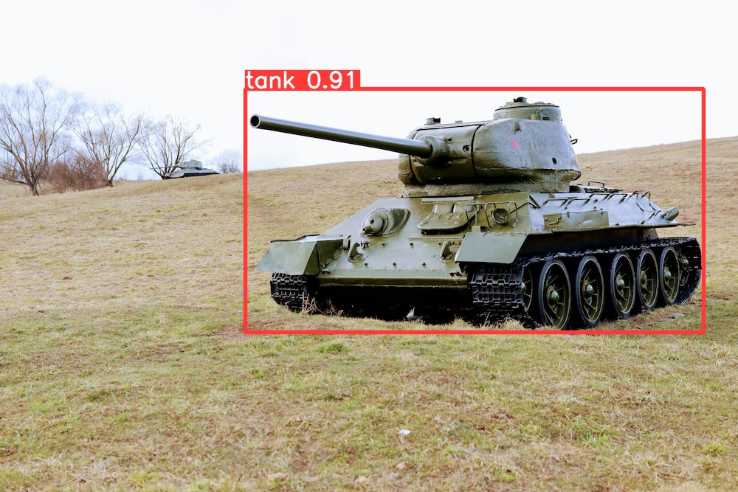

Slide 17

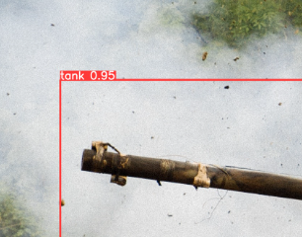



Slide 18





Slide 19

Changing brightness for Yolov5
Brightness 1.5:
Notes:
We set the brightness to 1.5 to obtain the execution times for the 6 images we selected. From the terminal we can gather that the average time for each stage was 22.79 seconds. The minimum time was 22.50 seconds and the max time was 23.10 seconds

Slide 20






Notes:
These are the scores for each images following the test results.

Slide 21

Changing brightness for yolov5
Brightness: 1.2
Notes:
To compare with the previous data at 1.5 brightness, we set the brightness to 1.2 in order to determine the speed. The average execution time for 1.2 seconds was 22.60 seconds with a minimum time at 22.60 seconds. The minimum time is 21.34 seconds and max time is 23.13 seconds.

Slide 22






Notes:
Compared to the results from 1.5 brightness, the 1.2 brightness provides higher confidence that the program can recognize the image as the confidence scores are consistently higher.

Slide 23

Changing contrast for Yolov5
Contrast 1.2:
Notes:
We will now compare the contrasts between the values 1.2 and 1.5 starting at 1.2. The average execution time at contrast 1.2 is 22.70 seconds with a minimum at 22.26 seconds and a maximum at 22.96 seconds

Slide 24






Notes:
At 1.2 contrast the confidence scores consistently hit at.90 with one image at 0.72

Slide 25

Changing contrast for Yolov5
Contrast 1.5:
Notes:
Now we test the contrast starting with the value set at 1.5. The average execution time was 22.40 seconds with 21.61 seconds minimum and 23.66 seconds maximum.

Slide 26






Notes:
At 1.5 contrast, there was overall less confidence compared to 1.2 as three images fell below 0.90

Slide 27
Link to powerpoint:
https://docs.google.com/presentation/d/1JjL62PPhDaUbsumT2pJYSsnBwfdhTSS1dVw2RBw563M/edit?usp=sharing

Slide 28

Videos: Running Yolov8 and Yolov5

Slide 29

Video: Running YoloV8

Slide 30


Running Brightness Yolov8 Running
contrast Yolov8

Slide 31

Video: Running YoloV5 Running
bright/contrast

